Slide 1
Chapter 4
Continuous Variables and Their Probability Distributions
1

Slide 2
Objectives
Continuous Random Variable
Cumulative Distribution Function
Expected Values of a Continuous Random Variable
Properties of Expected Values of a Continuous Random Variable

Slide 3
Random Variables
RV
Discrete
Continuous
3

Slide 4
Continuous Random Variable
A continuous random variable is one which takes an infinite number of possible values.
Continuous random variables are usually measurements.
Examples:
height
weight
the amount of sugar in an orange
the time required to run a mile

Slide 5
Continuous Random Variable
If a random variable can take on any value between two values, it is called a continuous random variable.
A continuous random variable is NOT defined at specific values.
Instead, it is defined over an interval of values.
The probability of observing any single value is equal to 0, since the number of values which may be assumed by the random variable is infinite.

Slide 6

Density function of Continuous RV
Suppose a random variable X may take all values over an interval A of real numbers.
Then the probability that X is in the set of outcomes A, P(A), is defined to be the area above A and under a curve.
That is,
P( X $∈$ A) = Area above A and under a curve
P (a ≤ X ≤ b) = the area under the density curve
between a and b

Slide 7
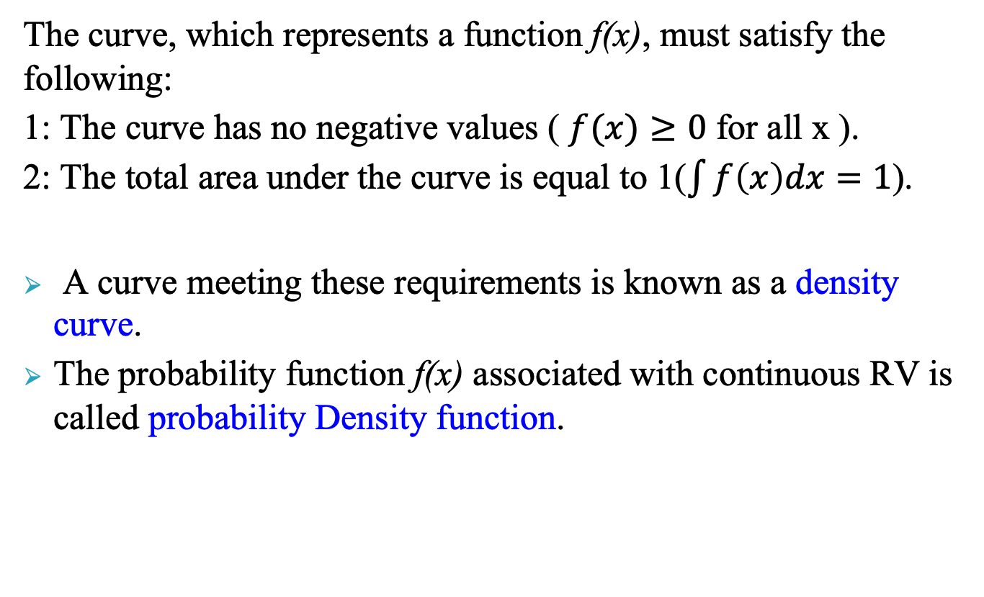
Density function of Continuous RV
The curve, which represents a function f(x), must satisfy the following:
1: The curve has no negative values ( $f(x)≥0$ for all x ).
2: The total area under the curve is equal to 1($\int{f\left(x\right)dx=1}$).
A curve meeting these requirements is known as a density curve.
The probability function f(x) associated with continuous RV is called probability Density function.

Slide 8
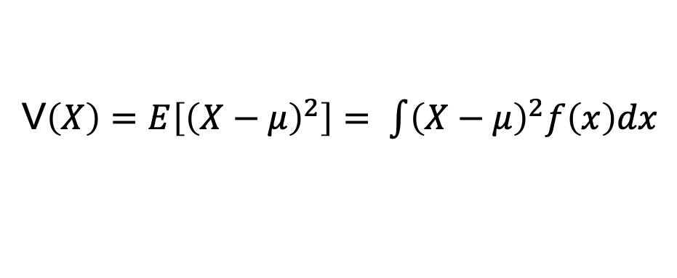
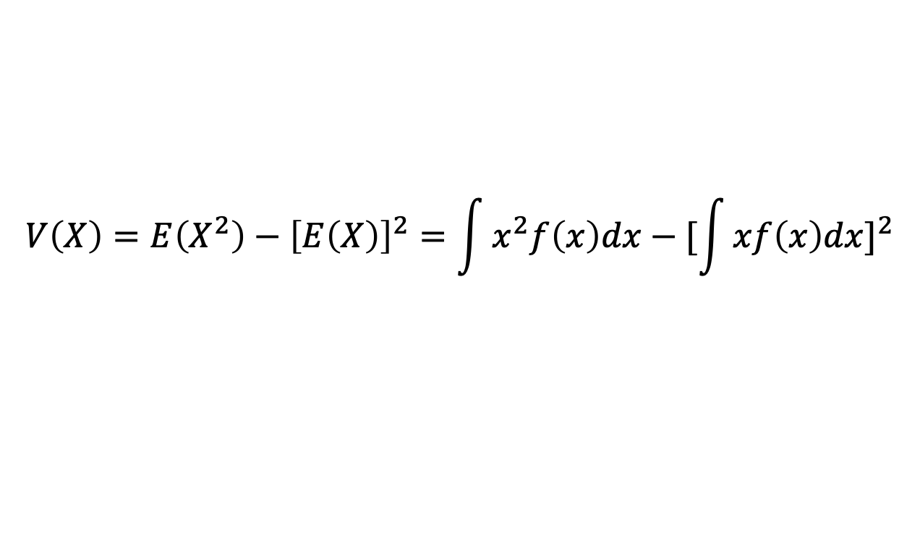
Expected Values of Continuous RV
For a continuous random variable:
V$\left(X\right)=E\left[{\left(X−μ\right)}^{2}\right]= \int{{\left(X−μ\right)}^{2}f\left(x\right)dx}$
or
$$V\left(X\right)=E\left(X^{2}\right)−{\left[E\left(X\right)\right]}^{2}=\int{x^{2}f\left(x\right)dx−{[\int{xf\left(x\right)dx}]}^{2}}$$
8
Notes:
QTM1310/ Sharpe
8

Slide 9
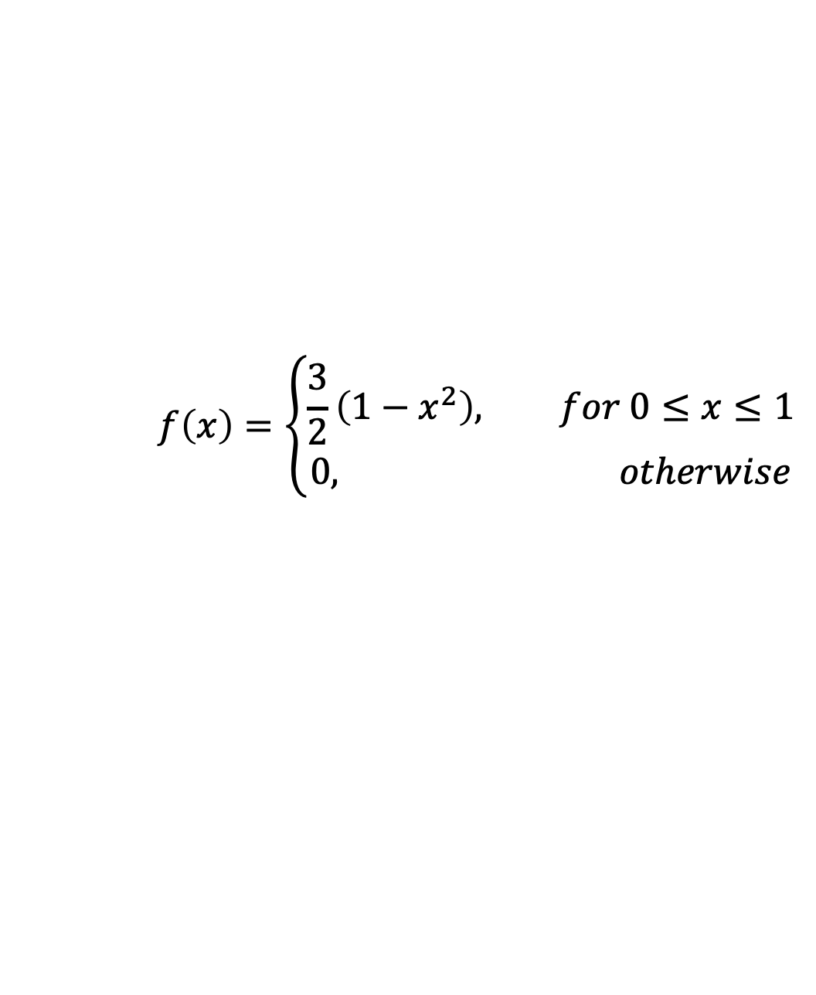
Example
The pdf of weekly gravel sales X was
Find the E(X), V(X) and SD(X).
Sol
$$f\left(x\right)=\left\{\begin{aligned}\frac{3}{2}\left(1−x^{2}\right), for 0≤x≤1 \\ 0, otherwise\end{aligned}\right.$$

Slide 10
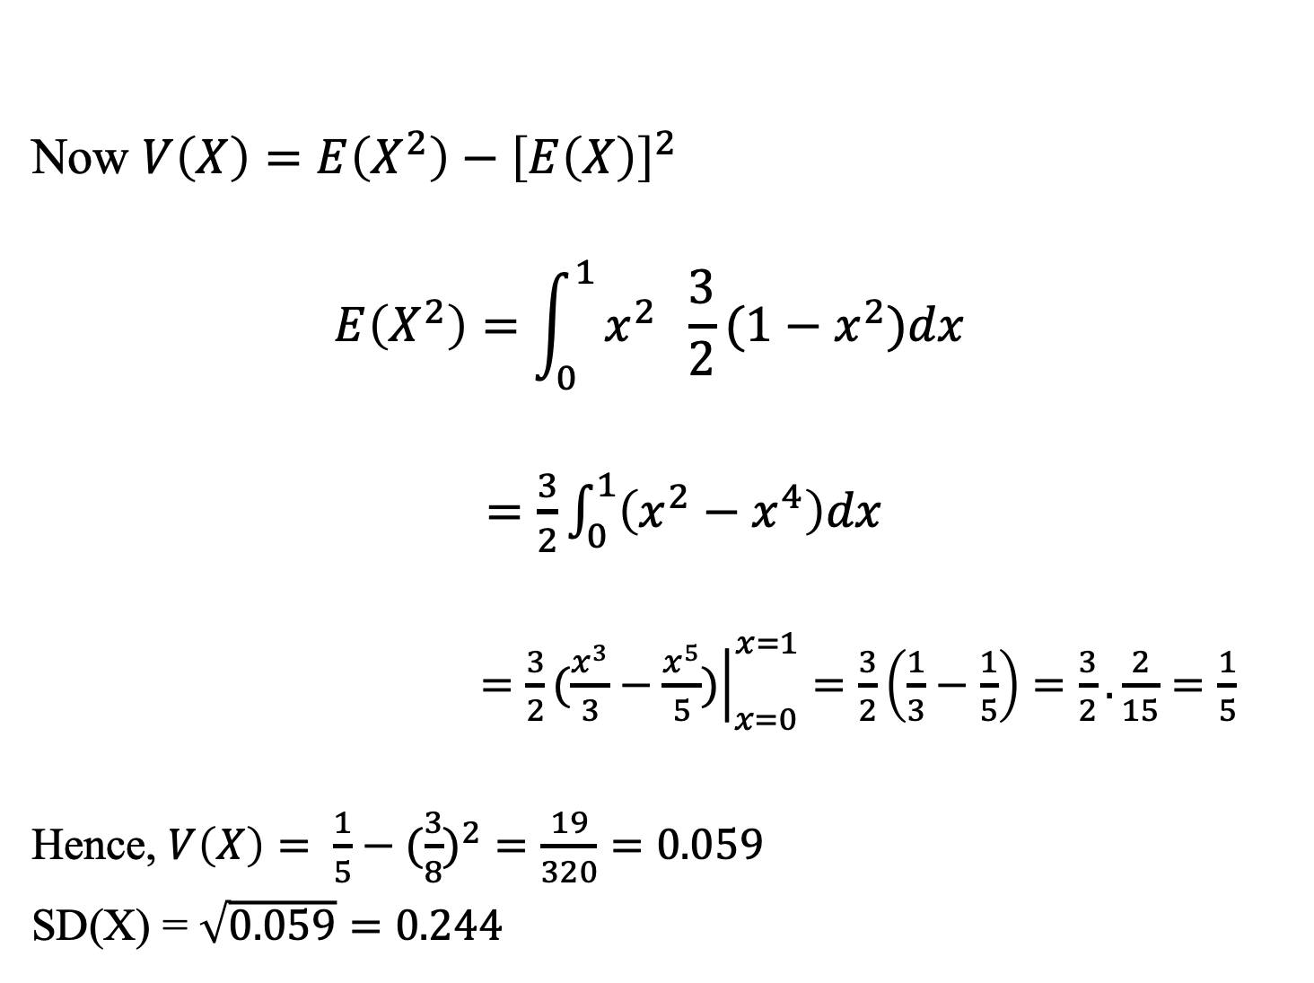
Example (cont’d)
Now $V\left(X\right)=E\left(X^{2}\right)−{\left[E\left(X\right)\right]}^{2}$
$$E\left(X^{2}\right)=\int_{0}^{1}{x^{2} \frac{3}{2}(1−x^{2})dx}$$
$=\frac{3}{2}\int_{0}^{1}{\left(x^{2}−x^{4}\right)dx}$
$=\frac{3}{2}{\left.(\frac{x^{3}}{3}−\frac{x^{5}}{5})\right|}_{x=0}^{x=1}=\frac{3}{2}\left(\frac{1}{3}−\frac{1}{5}\right)=\frac{3}{2}.\frac{2}{15}=\frac{1}{5}$
Hence, $V\left(X\right)= \frac{1}{5}−({\frac{3}{8})}^{2}=\frac{19}{320}=0.059$
SD(X) = $\sqrt{0.059}=0.244$

Slide 11
Properties of Expected Values
Adding a constant c to X:
Multiplying X by a constant a:
Addition Rule for Expected Values
11
Notes:
QTM1310/ Sharpe
11

Slide 12
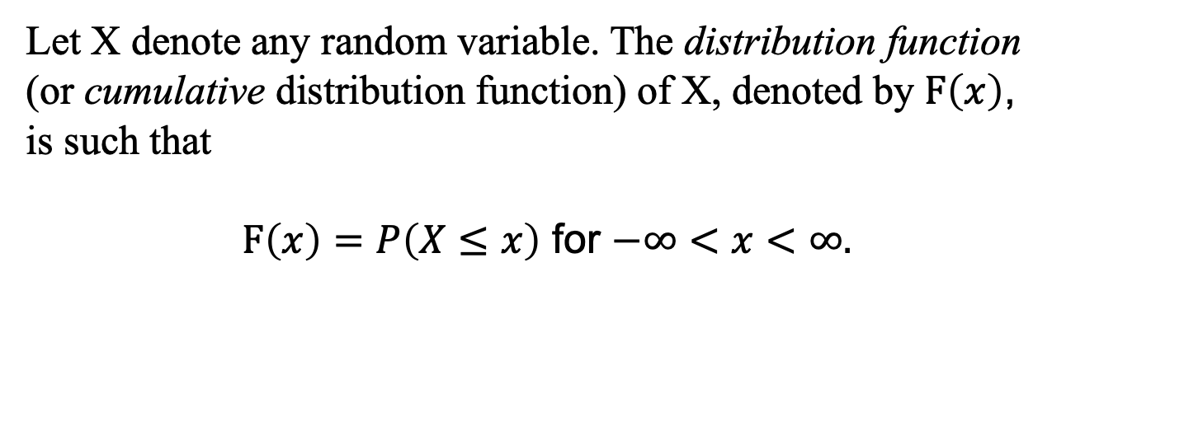
The Cumulative Distribution Function (CDF)
Let X denote any random variable. The distribution function (or cumulative distribution function) of X, denoted by $F\left(x\right)$,
is such that
$F\left(x\right)=P\left(X≤x\right)$ for $−∞<x<∞.$
The nature of the distribution function associated with a random variable determines whether the variable is continuous or discrete.

Slide 13
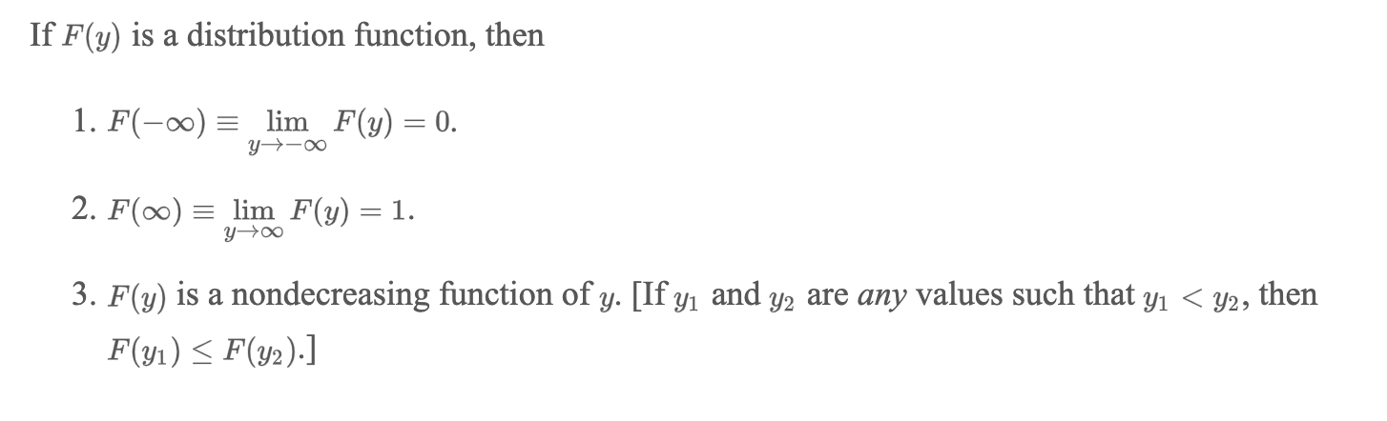
Properties of CDF

Slide 14
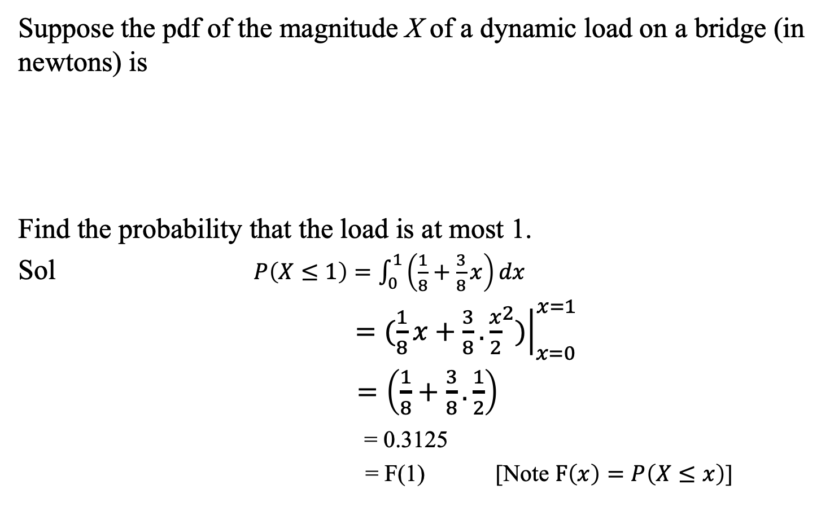
Example
Suppose the pdf of the magnitude X of a dynamic load on a bridge (in newtons) is
Find the probability that the load is at most 1.
Sol $P\left(X≤1\right)=\int_{0}^{1}{\left(\frac{1}{8}+\frac{3}{8}x\right)dx}$
$={\left.(\frac{1}{8}x+\frac{3}{8}.{\frac{x}{2}}^{2})\right|}_{x=0}^{x=1}$
$=\left(\frac{1}{8}+\frac{3}{8}.\frac{1}{2}\right)$
= 0.3125
= F(1) [Note $F\left(x\right)=P\left(X≤x\right)$]

Slide 15
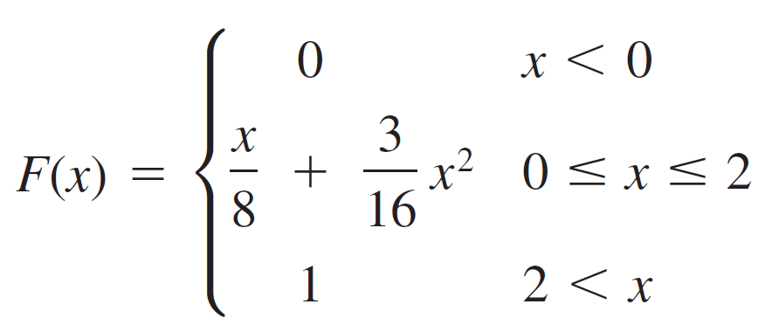
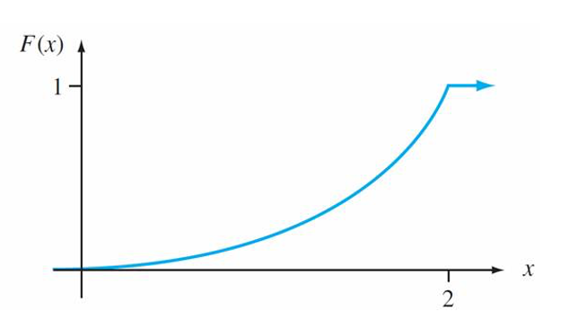
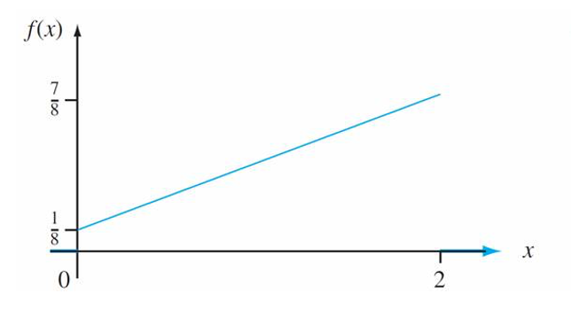
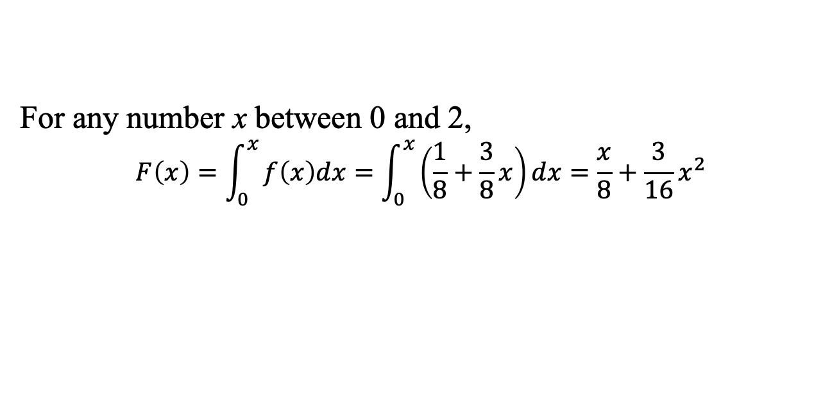
Example (cont’d)
For any number x between 0 and 2,
$$F\left(x\right)=\int_{0}^{x}{f\left(x\right)dx=\int_{0}^{x}{\left(\frac{1}{8}+\frac{3}{8}x\right)dx=\frac{x}{8}+\frac{3}{16}x^{2}}}$$
Hence,

Slide 16

Obtaining f(x) from F(x)

Slide 17
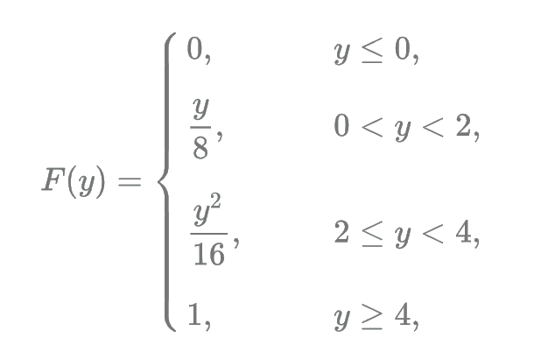
Exercise
If Y has following distribution function then find the mean and variance of Y.
Answer: E(Y) = 31/12 and V(Y) = 1.160

